Slide 1

CREDIT CARD
PILOT PROJECT – MITRON BANK
Pilot project using customer data across five cities to validate Mitron Bank’s new credit card strategy.
By Sourav Paul

Slide 2

INDEX
Introduction – Background of Mitron Bank and the new credit card initiative
Problem Statement – Current pain points and market challenges
Objective – Purpose of the pilot project and expected outcomes
Target & Goal – Key focus areas and success aspirations
Dataset Overview – Sample of 4,000 customers across five cities with spending details
Insights & Findings – Preliminary analysis and business implications
Conclusion – Summary and next steps for full-scale implementation

Slide 3

INTRODUCTION
MITRON BANK
Mitron Bank, a well-established financial institution headquartered in Hyderabad, is planning a significant strategic expansion initiative
The organization seeks to strengthen its market presence by introducing an innovative line of diverse credit card products.
This move demonstrates the bank’s intent to modernize offerings, attract new customers, and remain competitive in today’s landscape.

Slide 4

ABOUT OUR
PROBLEM STATEMENT
Mitron Bank aims to explore new opportunities by introducing credit cards, requiring data-driven validation first.
Without innovative credit card offerings, the bank struggles to attract younger customers and sustain long-term growth.

Slide 5


ABOUT OUR
OBJECTIVE
Mitron Bank’s challenge lies in limited product diversification, requiring data-driven insights to design competitive credit card offerings.
Validating credit card strategy through data insights to drive growth and competitiveness for Mitron Bank

Slide 6

ABOUT OUR
ABOUT OUR
TARGET
GOAL
Identify customer spending patterns across five cities to design appealing credit card products.
Launch competitive credit cards using pilot insights, enhancing market reach and customer engagement.

Slide 7


KNOW ABOUT
CREDIT CARD TYPES
1
BASIC CREDIT CARD:
Entry-level card with minimal features, low fees, suitable for everyday spending and building credit.
2
REWARD/CASHBACK CREDIT CARD:
Offers points or cashback on purchases, incentivizing spending through financial rewards.
3
PREMIUM CREDIT CARD:
High-end card with exclusive benefits like lounge access, concierge, and higher rewards for affluent customers.
4
CO-BRANDED CREDIT CARD:
Partnered with brands for exclusive discounts, rewards tailored to specific merchants or services.
5
BUSINESS CREDIT CARD:
Designed for business expenses; offers spending controls, detailed reports, and tailored rewards for professionals.

Slide 8

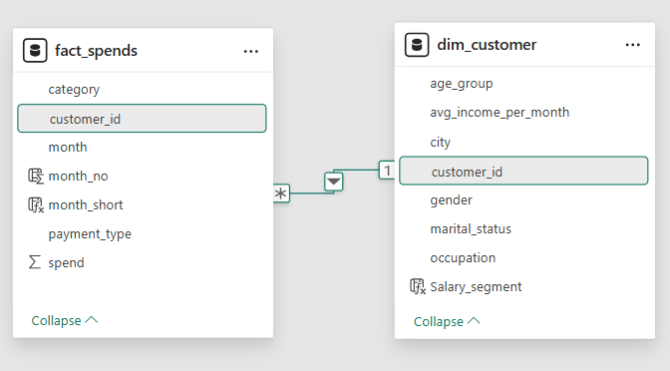
DATA SET OVERVIEW
KEY INSIGHTS
Total Customers: 4,000 unique customer profiles
Coverage: Five major cities – Mumbai, Delhi-NCR, Chennai, Hyderabad, Bengaluru
Demographics: Gender, age group, marital status, occupation, and income levels
Spending Data: Six months of transactions (May–October) across multiple categories
Payment Modes: Debit Card, Credit Card, UPI, and Net Banking

Slide 9
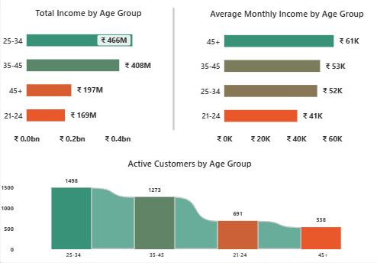
INSIGHTS
AND FINDINGS
INCOME BY AGE GROUP
“The 25–45 age group forms Mitron Bank’s strongest segment, combining the largest customer base with the highest total income contribution.
While the 45+ group shows premium earning potential, the 21–24 group represents an emerging opportunity for entry-level credit card offerings.
“Mid-aged customers (25–45) dominate both income and customer volume, making them the prime target segment. The 45+ group offers niche high-income potential, while younger 21–24 customers can be nurtured for future growth.”

Slide 10
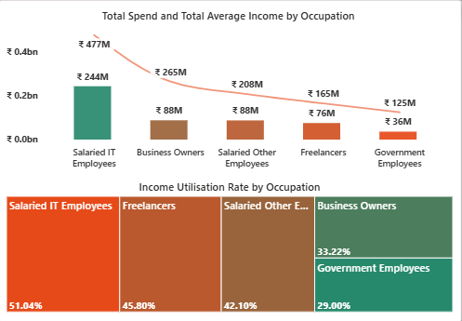
INSIGHTS
AND FINDINGS
INCOME BY OCCUPATION
Income & Spending: Salaried IT employees dominate with the highest total income (₹477M) and spending (₹244M), indicating strong purchasing power. Business owners and salaried others contribute moderately, while freelancers and government employees remain lower contributors overall.
Income Utilisation: IT employees (51%) and freelancers (45.8%) spend a significant share of their income, showing higher engagement. In contrast, government employees (29%) and business owners (33%) spend conservatively, reflecting cautious financial behavior.
IT employees drive the highest income and spending, while freelancers show strong utilisation; government employees remain conservative

Slide 11
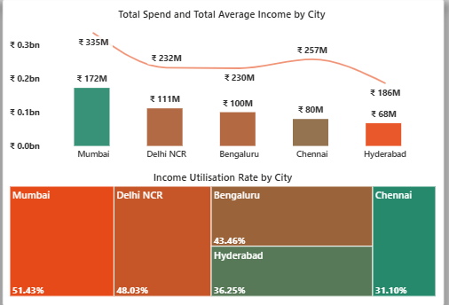
INSIGHTS
AND FINDINGS
INCOME BY CITY
Income & Spending: Mumbai customers lead with the highest income (₹335M) and spending (₹172M), followed by Delhi NCR and Bengaluru. Chennai and Hyderabad contribute comparatively lower overall income and spending levels.
Income Utilisation: Mumbai (51.4%) and Delhi NCR (48%) show the strongest utilisation rates, indicating higher engagement. In contrast, Chennai (31.1%) and Hyderabad (36.2%) demonstrate more conservative spending relative to their income.
Mumbai leads both income and spending with highest utilisation, while Chennai shows lowest spending engagement.

Slide 12
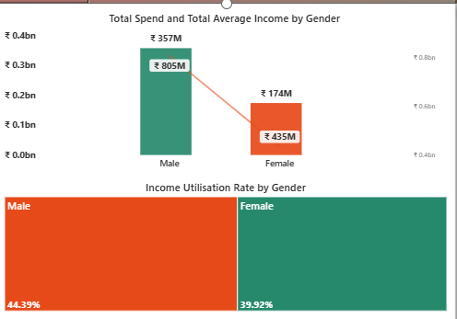
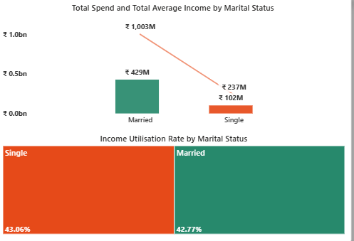
INSIGHTS
AND FINDINGS
INCOME BY GENDER AND MARITAL STATUS
Income & Spending: Males contribute the highest income (₹805M) and spending (₹357M), while females contribute ₹435M income and ₹174M spending.
Income Utilization: Males (44.4%) show slightly higher utilization compared to females (39.9%), indicating stronger spending relative to income.
Income & Spending: Married customers dominate with income ₹1,003M and spending ₹429M, while singles contribute significantly less (₹237M income, ₹102M spending).
Income Utilization: Singles (43.1%) and married (42.8%) show nearly similar utilization, suggesting consistent spending habits across both groups.

Slide 13
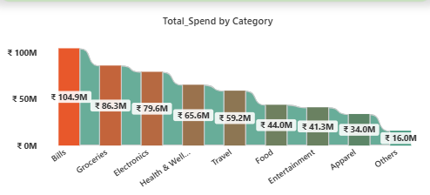
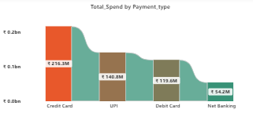
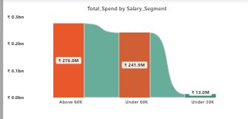
INSIGHTS
AND FINDINGS
TOTAL SPENDING BY CATEGORY, PAYMENT TYPE AND SALARY SEGMENT
Spending Patterns: Bills (₹105M) and Groceries (₹87M) dominate, followed by Electronics (₹80M) and Health & Wellness (₹66M). Categories like Apparel (₹34M) and Others (₹16M) see lower spends.
Interpretation: Essential needs drive the majority of spending, while lifestyle categories present untapped potential for credit card offers.
Spending Distribution: Credit Cards lead with ₹216M, followed by UPI (₹141M), Debit Cards (₹120M), and Net Banking (₹54M).
Interpretation: Credit card usage is already the strongest, but UPI adoption highlights evolving digital-first customer preferences.
Income & Spending: Customers earning above ₹60K contribute the highest spending (₹276M), closely followed by under ₹60K (₹242M). Very minimal spending comes from under ₹30K (₹13M).
Interpretation: Higher earning groups dominate overall spending, but mid-segment (<₹60K) also shows strong engagement worth targeting.

Slide 14
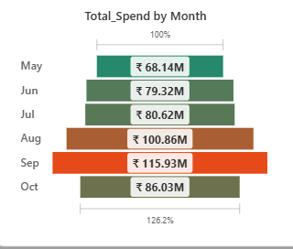
INSIGHTS
AND FINDINGS
SPENDING BY MONTHS
The sharp rise in total spend during August and September, peaking at ₹115.93M, strongly indicates heightened customer activity likely driven by festive season shopping and related.
Spending patterns suggest that the festive season has a major impact on monthly transaction volumes, with a notable increase ahead of and during celebratory months.

Slide 15

CONCLUSION
Target the 25-34 years age group primarily with rewards and cashback credit cards to leverage their strong e-commerce engagement.
Offer partnership-driven cashback promotions and maintain minimal annual fees to attract and retain this younger segment.
For the 35-45 years age group, focus on premium credit cards with luxury perks like airport lounge access.
Introduce business credit cards with higher limits and business-specific rewards tailored to professionals in this segment.
This dual-segment approach aligns product features with customer preferences, maximizing acquisition and revenue potential.

Slide 16



THANK
YOU
Thank you for the opportunity to assist with your credit card strategy analysis. Your vision and insights are commendable, and it has been a pleasure supporting you in crafting a targeted, data-driven approach. Wishing Mitron Bank great success in launching innovative products that truly resonate with your customers
+91-7003252199
souravpaulofficial101@gmail.com

